Slide 1
MATLAB ASSIGNMENT 1
GROUP 16

Slide 2
GROUP 16 MEMBERS
NO. | STUDENT NAME | REG. NO. | COURSE | SEX | GITHUB LINK
1 | KABWERU ANDREW | BU/UG/2024/5057 | WAR | M | https://github.com/kabweruandrew39-alt/Andrew.git
2 | CHEMONGES MIKIRAR | BU/UP/2024/1005 | WAR | M | https://github.com/Chemonges-mikirar/Chemonges
3 | NAGASHA RITTA | BU/UG/2024/5055 | AMI | F | https://github.com/Nagasharitah/Nagasha-Ritta.git
4 | DIKITAL JOHN | BU/UP/2024/1125 | WAR | M | https://github.com/JOHNDIKITAL/johndikitalmatlab.git
5 | SANYU JOY | BU/UP/2024/5348 | MEB | F | https://github.com/joysanyu22-cell/SANYU-JOY.git
6 | OULE SADOCK | BU/UP/2024/0844 | AMI | M | https://github.com/oulesadock25/Oule-Sadock-.git
7 | WANGUSI DAVID | BU/UP/2024/5350 | MEB | M | https://github.com/wangusid22/WANGUSI-DAVID.git
8 | SEBATIKA COLLINE | BU/UP/2024/0845 | AMI | M | https://github.com/SebyatikaColline/Sebyatika-Colline.git
9 | ATYANG MILDRED | BU/UP/2024/1019 | WAR | F | https://github.com/mildredmoreen/ATYANG-MILDRED-.git
10 | KITUTU LEONARD | BU/UP/2024/1035 | WAR | M | https://github.com/leonardkitutu1-hue/leonard-kitutu.git

Slide 3
INTRODUCTION TO MATLAB
MATLAB, which stands for matrix laboratory, is a high-performance programming language and environment designed primarily for technical computing
The first version of MATLAB was created in Fortran in the late 1970s as a simple interactive matrix calculator. This early iteration was built on top of two significant mathematical libraries: LINPACK and EISPACK, which were developed for numerical linear algebra and eigenvalue problems, respectively.
MATLAB was officially launched as a commercial product in 1984 by MathWorks, a company founded by Moler along with Jack Little and Steve Bangert. The software was reimplemented in C, with the addition of user-defined functions, toolboxes, and graphical interfaces.
Recent versions of MATLAB have introduced features like the Live Editor, which allows users to create interactive documents that combine code, output, and formatted text. This evolution reflects MATLAB's ongoing adaptation to meet the needs of its diverse user base across academia and industry.

Slide 4
NUMBER ONE
Retrieving data from kaggle.com, loading it into mat lab and carrying out required operations
We were able to import, retrieve a dataset from Kaggle.com, importing it to MATLAB, converting tables into structural arrays, outputting variables in to a single workbook with each year on separate sheets having clear column headings and sheet names.
STEPS FOLLOWED
Open Kaggle.com website from Google chrome.
Sign in to Kaggle.com and download any desired excel dataset and zip it in to a desired folder, whereby we obtained “coffee sales” dataset
Copy the file path into MATLAB.
In home tab, click on new script to open the editor.
Save the script as “GROUP16”. And save it in the directory that is in your MATLAB path or current working directory.

Slide 5
WORKING PROCEDURE
Step 1: downloading excel file
Step 2: reading the excel file into MATLAB.
Step 3: converting Date column format to datetime(dd/mm/yyyy).
Step 4: creating a column for year.
Step 5: finding unique years in the data
Step 6: looping through each year, creating a table and struct.

Slide 7
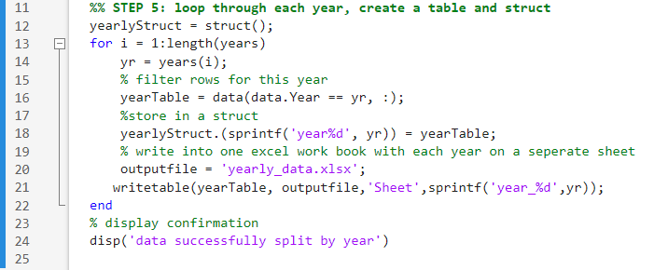

Slide 8
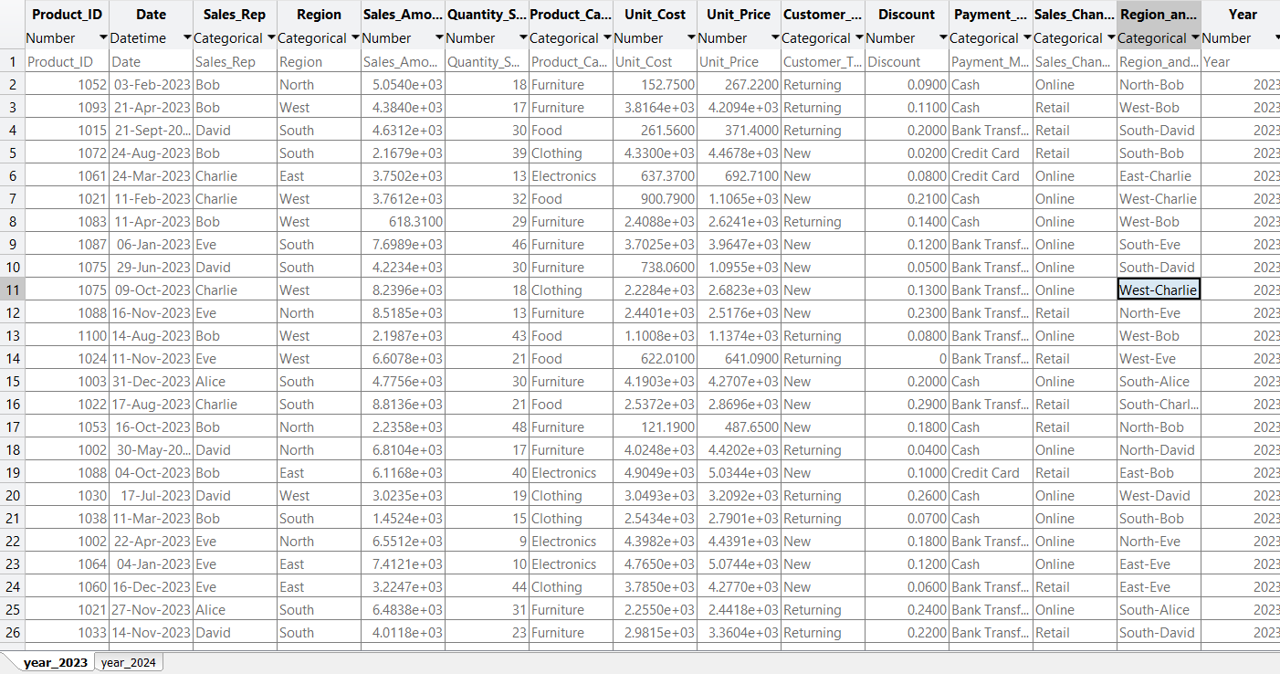
Results

Slide 9
NUMBER TWO
Writing a mat lab code that stores member’s attributes in a single variable and saves the value
Step 1: downloading excel file
Step 2: reading the excel file into MATLAB.
Step 3: converting Date column format to datetime(dd/mm/yyyy).
Step 4: creating a column for year.
Step 5: finding unique years in the data
Step 6: looping through each year, creating a table and struct.

Slide 10
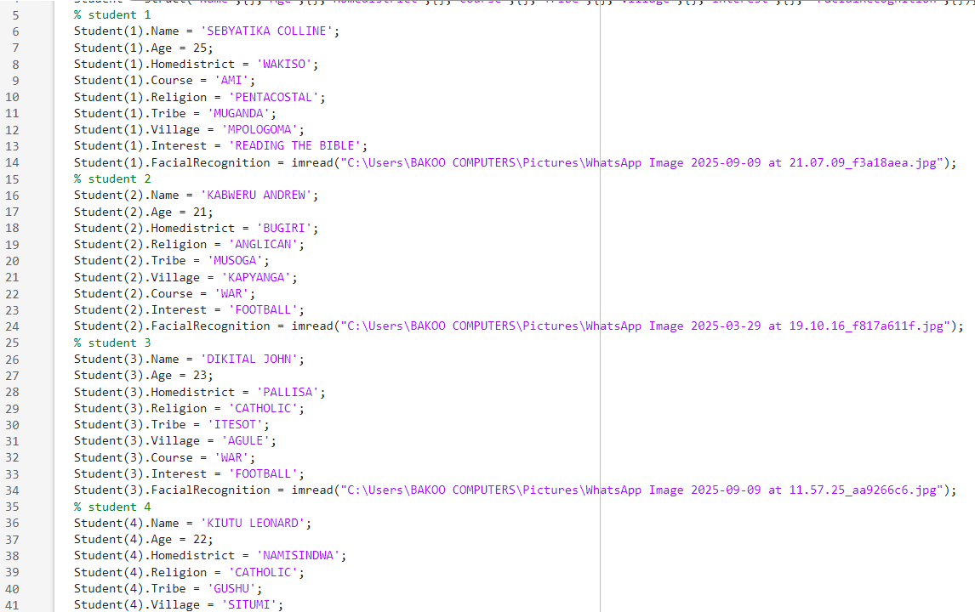

Slide 11
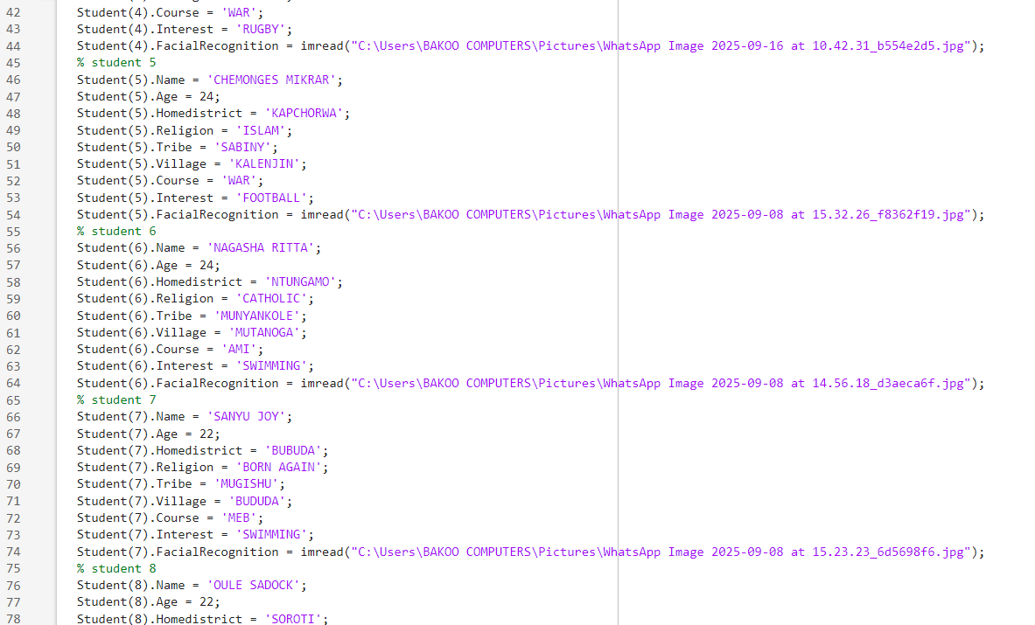

Slide 12
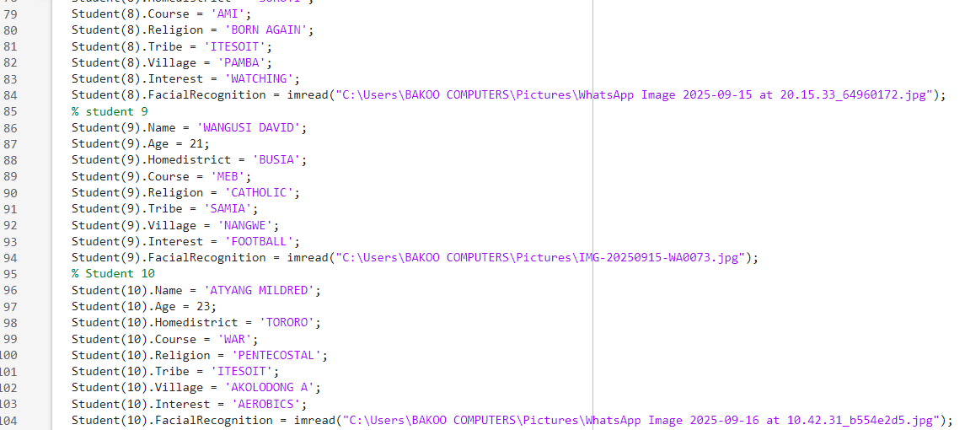

Slide 13

Saving The Variable
Using the save function, we saved the variable as “Students.mat”

Slide 14
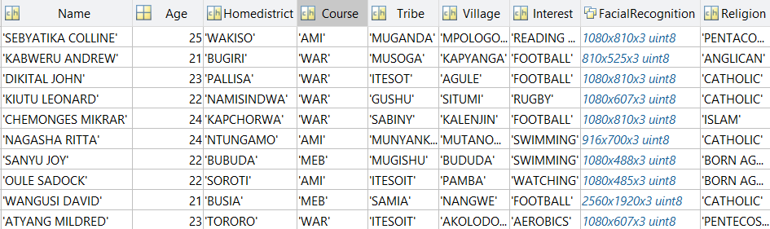
RESULTS

Slide 15
CONCLUSION
Exposure to Kaggle.com proves to be fruitful as it holds a variety of datasets serving as a source of information to group students. The assignment has furthermore enabled students to convert tables into structural arrays, output variables into a single workbook and write code that stores multiple information into a single variable.
Use of MATLAB to organize personal attributes makes data analysis simpler and effective

Slide 16
THANK YOU
Group 16

